Slide 1
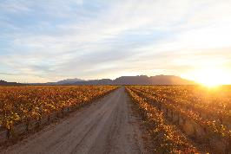


corporate overview
Cadiz Inc.
March 2017

Slide 2
SAFE HARBOR AGREEMENT
December 2016
During the course of this presentation, we will make forward-looking statements. Any statement that is not a historical fact is a forward-looking statement. Forward-looking statements refer to expectations, projections or other characterizations of future events or circumstances about Cadiz, Inc. (the “Company”), and such statements include, but are not limited to, statements relating to the progress and plans of the water development project; the opportunities with CRA; discussion with BLM regarding railroad right-of-way; contracts with water providers; estimated costs of construction; and the expected pricing for water supply and water storage services. Actual results may differ materially from those expressed in these forward-looking statements due to a number of risks and uncertainties, including the factors detailed under the caption “Risk Factors” and elsewhere in the documents we file from time to time with the Securities and Exchange Commission (the “SEC”), including our annual and quarterly reports. We undertake no obligation to update these forward-looking statements, which speak only as of the date of this presentation.
Cadiz Inc.

Slide 3
ABOUT CADIZ
Renewable resources company (NASDAQ: CDZI) with diverse land and water assets, including –
45,000 acres of land w/ abundant
groundwater resources.
Agriculture is a zoned use on all
properties.
Permits to farm on 9,600 acres in
Cadiz Valley, with long-term leasing
arrangement on 2,100 acres.
Approved state and county permits to
implement new water supply project in
Southern California.

Slide 4
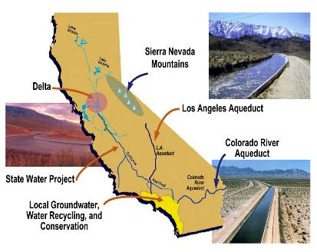

MARKET OVERVIEW - California
  California suffers from a systemic shortage of supply vs. demand. All available supplies are insufficient to meet projected demands.
  Climate extremes (drought to flood) place added pressure on state water infrastructure.
  Investments in local supplies is required to meet projected demands.
  Innovation will be required to enable the State to meet this challenge; e.g. new supplies and groundwater storage..

Slide 5
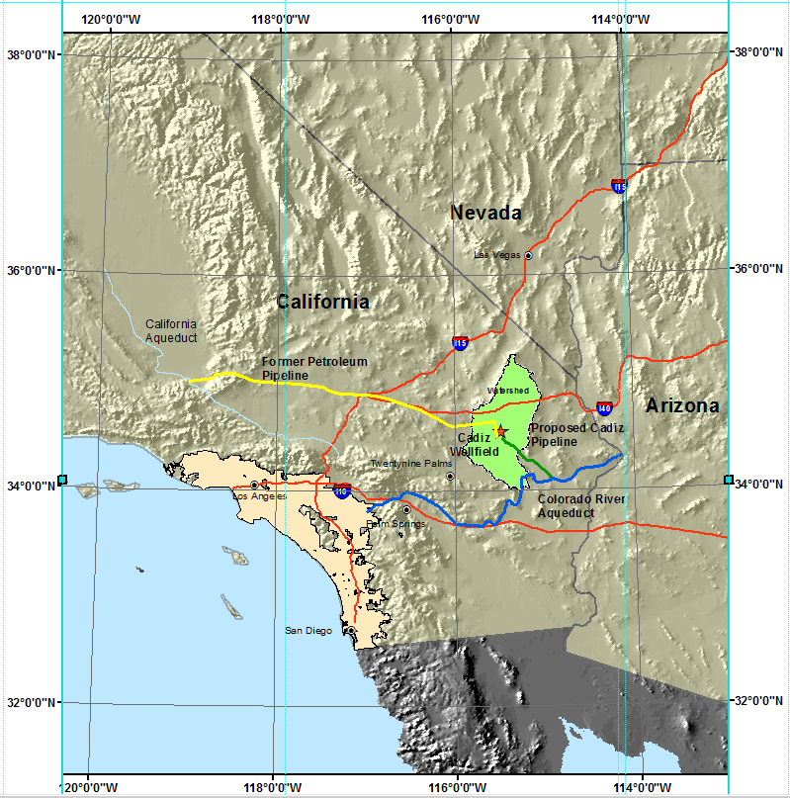
Cadiz Area Water Resources
1,300 sq. mile watershed in Mojave Desert
Aquifer system holds approx. 20 million acre-feet (AF), comparable to Lake Mead.
Natural recharge 32,500 AF/year.
Cadiz Inc. only significant overlying land user.
Prolific groundwater resource provides irrigation for active agricultural operation.

Slide 6
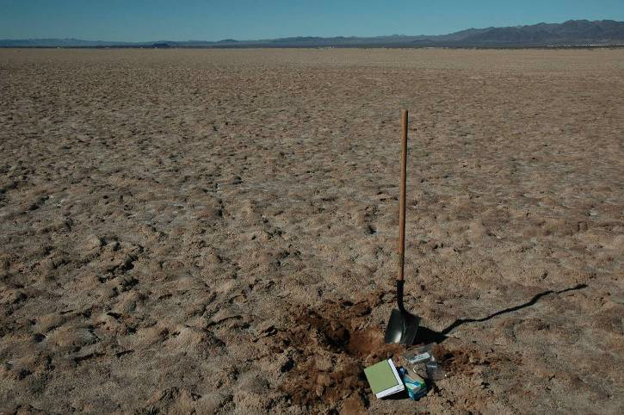
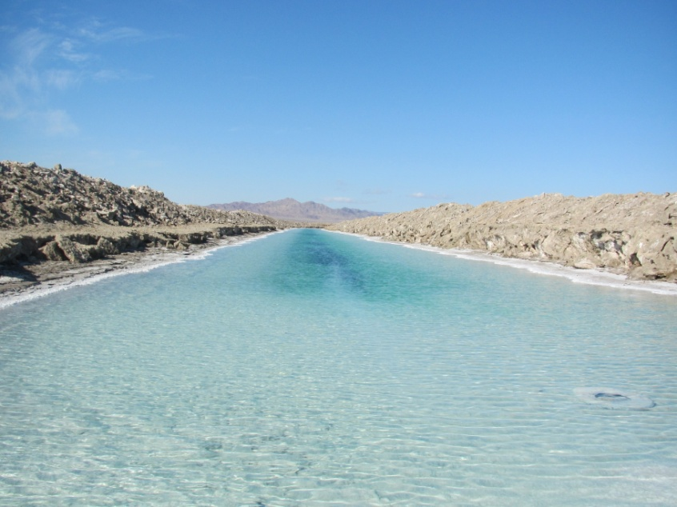
Water Resources (cont…)
Bristol Dry Lake Crust
Beneath Dry Lake Surface
Cadiz/Fenner Watershed terminates at dry lake playas where groundwater is presently evaporating.
Groundwater beneath dry lake surface is highly saline (10 times the salinity of Pacific Ocean).

Slide 7
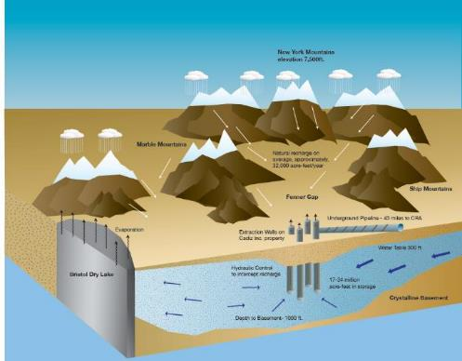
Cadiz Valley Water Conservation, Recovery & Storage Project
Phase 1 - Innovative &
Sustainable Water Source for Southern California
Expand wellfield on Cadiz Inc. ag property.
Capture and conserve average of 50,000 AF/year for 50 years.
Create new supply for 400,000 people.
Contracts with retail providers in 7-county So. Cal. area.
Carry-over storage capacity in wet years.
No environmental impacts.

Slide 8
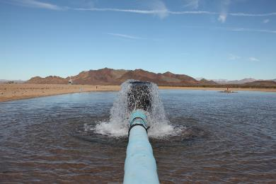
Cadiz Valley Water Conservation, Recovery & Storage Project
Phase 2 – Local Groundwater Storage
for Southern California
Via pipeline, import water in wet years and store underground at Cadiz.
Cadiz RR Pipeline and Cadiz Northern pipeline increase annual import capacity.
Total storage capacity = 1 million acre-feet.
Unique Southern California banking opportunity, “off CRA.”
Larger than local surface reservoirs..

Slide 9
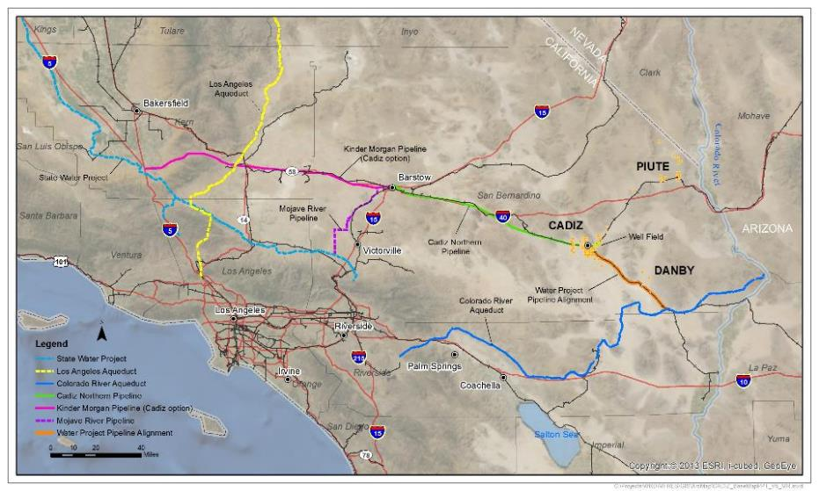
Phase 1 & 2 in Southern California

Slide 10
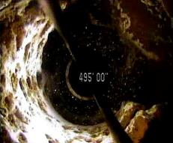
Phase 1 Project Development
Hydrological Evaluation
  2009 – 2012: Modeling, Fieldwork, Peer review
  2012 – 2015: Engineering, Well drilling, Project design
Public Process
  2011 – 2012: California Environmental Quality Act
  (CEQA) public review
  Jul 2012: Certified EIR by Santa Margarita Water District
  Oct 2012: Groundwater Extraction Approval by San Bernardino County.
Legal Review
  2012 - 2014: Superior Court upheld all action, denied all claims against.
  2015 - 2016: California Court of Appeal upheld all Superior Court rulings.

Slide 11
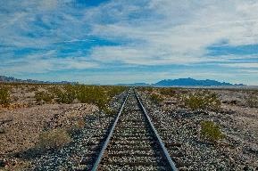
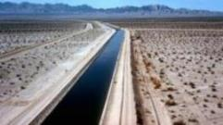
Phase 1 Implementation – final steps
BLM ROW
    Water pipeline to be constructed along active railroad ROW from Cadiz to CRA.
    Controversial BLM Letter in 2015 recommends additional permits.
    2017 brings new Administration & Congressional activities:
      BLM to reconsider Oct. 2015 guidance letter.
      Bill language to ensure future co-location of utilities within railroad ROWs, including Cadiz.
Final Contracts
  Participating agencies finalize contracts and transportation arrangements.

Slide 12
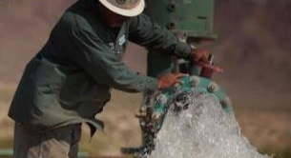
Phase 1 Construction & Contracts
Phase 1 build-out costs estimated at $250M, includes all facilities.
  Pipeline
  Wellfield
  Manifold
  Treatment
  Ancillary RR benefits
Long-term contracts on Project supplies @ $960/AF in 2014$
Storage reservations starting at $1,500/AF.

Slide 13
Water & Ag Land Pricing
    Wholesale cost of water +6%/yr. since 2002 thru 2018.
    Spot Market water prices in dry years + $2,000/AF
    Shortage of land with reliable water rights driving value of Ag acreage.
Sources: Metropolitan Water District of Southern California, http://www.mwdh2o.com/WhoWeAre/Management/Financial-Information &
CA American Society of Farm Managers and Rural Appraisers http://www.calasfmra.com/

Slide 14
Financials @ 3/1/17
Shares Outstanding | 22.1 M
Working Capital | $10.4 M
Debt – Sr. Secured * | $44.1 M
Debt – Convertible** | $68.4 M
Lease buy-back Provision *** | $14 M
* Senior Secured Mortgage - 8% Interest (4% PIK and 4% cash or stock quarterly at company option), Maturity September 2019.
** Convertible Notes - $1.3M Convert at $8.05/share, 7% Interest PIK, Maturity March 2018. $67.1M Convert at $6.75/share, 7% Interest PIK, Maturity March 2020.
*** Lease buy-back amount increases at 10% per Annum.

Slide 15
“Infrastructure investment strengthens our economic platform, makes America more competitive, creates millions of jobs, increases wages for American workers, and reduces the costs of goods and services for American families and consumers.
…With respect to infrastructure projects for which Federal reviews and approvals are required…the Chairman of the White House Council on Environmental Quality (CEQ) shall, within 30 days after a request is made, decide whether an infrastructure project qualifies as a "high priority" infrastructure project… With respect to any project designated as a high priority …, the Chairman of the CEQ shall coordinate with the head of the relevant agency to establish, in a manner consistent with law, expedited procedures and deadlines for completion of environmental reviews and approvals for such projects.”
– President Donald Trump, Executive Order: Expediting Environmental Reviews and Approvals for High Priority Infrastructure Projects, January 24, 2017

